Slide 1
Thamizharasi K 715521104050
Final Project
3/4/2024 Annual Review

Slide 2
PROJECT TITLE
Brain Tumour Detection Using Deep Learning
3/4/2024 Annual Review

Slide 3


AGENDA
Problem Statement
Project Overview
End Users
Our Solution and Proposition
Modelling Approach
Results
Conclusion
3/21/2024 Annual Review
3/4/2024 Annual Review

Slide 4

PROBLEM STATEMENT
"Develop a deep learning model capable of accurately detecting and classifying brain tumors from medical imaging data, such as MRI scans or CT scans. The model should be able to differentiate between different types of brain tumors (e.g., gliomas, meningiomas, metastatic tumors) and accurately localize the tumor within the brain. The primary objectives include achieving high sensitivity and specificity in tumor detection, minimizing false positives and false negatives, and providing interpretable outputs to assist medical professionals in diagnosis and treatment planning. Additionally, the model should be robust to variations in imaging quality, patient demographics, and tumor characteristics to ensure generalizability across different clinical settings."
3/4/2024 Annual Review

Slide 5

PROJECT OVERVIEW
Our project aims to develop a deep learning model for detecting and classifying brain tumors from MRI or CT scans. Key objectives include accurate tumor differentiation, precise localization, and interpretable outputs. We'll collect diverse data, develop a robust model, train and evaluate it for performance, and ensure interpretability and robustness across various settings.
Expected Outcomes:
Accurate brain tumor detection and classification.
Improved interpretability for medical professionals.
Rigorously validated model performance.
Advancements in brain tumor diagnosis and treatment planning.
3/4/2024 Annual Review

Slide 6

WHO ARE THE END USERS?
Individual investors
Financial analysts
Traders
Researchers
3/4/2024 Annual Review

Slide 7

YOUR SOLUTION AND ITS VALUE PROPOSITION
Our solution involves developing a state-of-the-art deep learning model for accurate brain tumor detection and classification using MRI or CT scans. By leveraging advanced machine learning techniques, we ensure:
1) Accurate Diagnosis: Differentiation between tumor types for informed treatment decisions.
2) Precise Localization: Exact tumor localization for targeted therapies and reduced procedural risks.
3) Minimized False Results: Rigorous training minimizes false positives and negatives, enhancing reliability.
4) Interpretable Outputs: Transparent outputs foster collaboration between the model and medical professionals.
5) Robustness and Generalizability: Extensive testing ensures reliability across diverse clinical settings.
3/4/2024 Annual Review

Slide 8

THE WOW IN YOUR SOLUTION
High accuracy
Real time prediction
seamless integration of cutting-edge technology and user-centric design, culminating in a powerful tool for stock market analysis and forecasting.
3/4/2024 Annual Review

Slide 9
MODELLING
Architecture Selection: Choose deep learning architectures suited for medical image analysis, such as CNNs like U-Net or DenseNet.
Data Preprocessing: Normalize, resize, and augment the dataset for consistency and improved performance.
Model Development: Implement the selected architecture optimized for accuracy and interpretability.
Training Strategy: Train the model on a split dataset, validating to prevent overfitting, and employ transfer learning if necessary.
Hyperparameter Tuning: Fine-tune hyperparameters using techniques like grid search or random search.
Evaluation Metrics: Assess model performance using standard metrics like accuracy, precision, recall, F1-score, and AUC.
Validation and Testing: Validate model on unseen data and conduct testing to ensure robustness across different imaging modalities and patient demographics.
This approach aims to develop a highly accurate and interpretable deep learning model for brain tumor detection and classification, ultimately improving healthcare outcomes.
3/4/2024 Annual Review

Slide 10
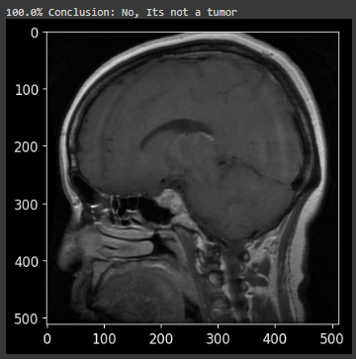
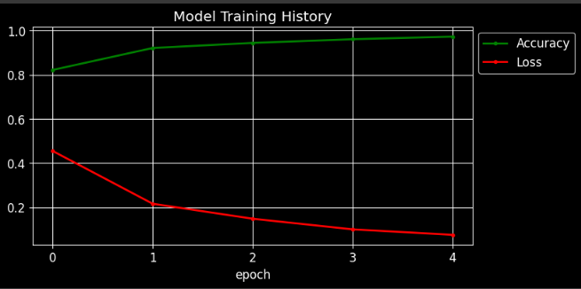
RESULTS
3/4/2024 Annual Review

Slide 11
CONCLUSION
Our project aims to develop a cutting-edge deep learning model for precise brain tumor detection and classification from MRI or CT scans. By leveraging advanced machine learning techniques, we strive to provide accurate diagnoses, precise tumor localization, and minimized false results. With interpretable outputs and robustness across various settings, our model promises to significantly improve brain tumor diagnosis and treatment planning, ultimately leading to better patient outcomes and more efficient healthcare delivery.
Github link:https://github.com/thamizharasikumar/NM.git
demolink:https://drive.google.com/file/d/1eHCWqPulPEj1DnvUT5VYYaeHoZrSBVF/view?usp=sharing

